Slide 1


University of Basrah College of Nursing
Newborns and Infants Stages
Fourth Lectures
Preper by :- assist lect. Noor salah shreaf

Slide 2

Neonate stage

Slide 3
Newborns Stage
Newborns (Neonates) stage
Newborn stage is the first 4 weeks or first month of life. It is a transitional period from intrauterine life to extra uterine environment.
Neonatal period: is period from birth to 28 days of life.
The 1st week: early neonatal period.
The next 3 weeks: late neonatal period

Slide 4
The Growth of neonate stage:-
1-Physical growth:-
1- Weight:
Weight = 2.700 – 4 kg
Wt loss 5% -10% by 3-4 days after birth
Wt gain by 10th days of life
Note : They lose 5 % to 10 % of weight by 3-4 days after birth as result of :
Withdrawal of hormones from mother.
Loss of excessive extra cellular fluid.
Passage of meconium (feces) and urine.
Limited food intake.

Slide 5
2- Height:-
Boys average Ht = 50 cm
Girls average Ht = 49 cm
Normal range for both (47.5- 53.75 cm)
3- Head circumference:
Head circumference: Range: 33-35 cm
Head is ¼ total body length
Skull has 2 fontanels (anterior & posterior)

Slide 6
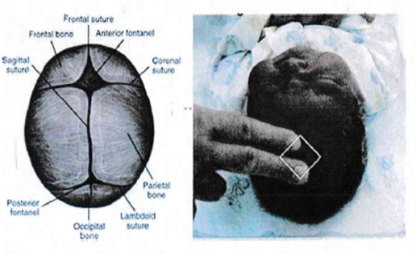

fontanels
Posterior fontanel closes 2 months of age.
Anterior fontanel closes by 12-18 months of age.

Slide 7
4- Chest circumference
Chest circumference: It is 30.5 to 33cm (usually 2–3cm less than head circumference).

Slide 8
2-Physiological growth
Vital signs
- Temperature (36.3 to 37.2°C ).
- Pulse (120 to 160 b / min ).
- Respiration (35 to 50 C /min)

Slide 9


Slide 10
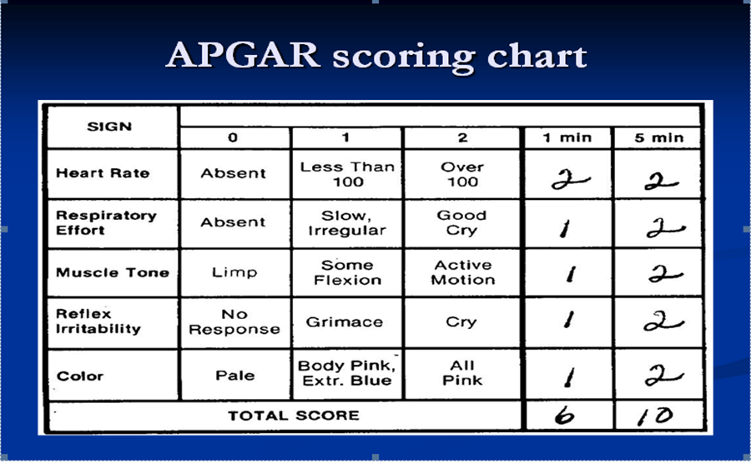

Slide 11
The Development of Neonate:-
1-Cognitive development:
• Cognition is the ability to think, learn, and remember.
• Newborn's brain is developing rapidly.
2-Emotional and Social Development:
• Newborns quickly learn to communicate.
• They seek interaction with mother or caregiver and express how they feel with sounds and facial expressions.
3-Language development:
• Newborn is listening to and absorbing the basic and different sounds of language.
• This process forms the foundation for speech.

Slide 12
4- Motor skills development: Newborns have all five senses.
- Gross Motor (Body Control and Skills):
a. Be able to turn his head from side to side when lying on his back.
b. Be able to lift his head for a brief second but he is unable to hold his head up by himself.
- Fine Motor (Hand and Finger Skills),
c. Newborn can bring his hands toward his mouth and suck on his fingers.

Slide 13
Reflexes of Newborns
reflexes are reflex actions originating in the central nervous system that are exhibited by normal infants, but not neurologically intact adults, in response to particular stimuli. These reflexes disappear or are inhibited by the frontal lobes as a child moves through normal child development. These primitive reflexes are also called infantile, infant or newborn reflexes. As general reflexes divided to 3 main group
Feeding (Rooting ,Gag And Swallowing, Sucking )
Protective (Cough ,Sneezing, Yawing ,Blinking )
Motor (Moro ,Startle ,Grasping ,Tonic-Neck, Stepping ,Babinski )

Slide 14


1. Blink reflex: a blink reflex in a newborn to protect the eye from any object (eyelid closure).
2. Rooting reflex: when touch near corner of mouth the child will turn the head in that direction. This reflex disappears at about sixth weeks of life.
3. Sucking reflex: when newborn's lips are touched the baby-makes a sucking motion. This reflex diminishes at about 6 months of age. reaches the posterior portion of the tongue is automatically swallowed. Gag, cough, and sneeze reflex also are present to maintain a clear airway.

Slide 15



5. Palmar grasp reflex: newborn will grasp an object placed in their palm by closing their fingers on it. Disappears at about 6 weeks to 3 months.
6. Step (walk) in place reflex: newborn who are held in vertical position with their feet touching at hard surface will take a few quick, alternating steps. Disappears by 3 months of age.
7. Plantar grasp reflex: when object touches the sole of a newborn's foot at the base of toes, toes grasp in same manner as the fingers do. Disappears 8-9 months.

Slide 16



8. Tonic neck reflex: when newborns lie on their backs, their heads usually turn to one side or the other. The arm and, the leg on the side to which the head turns extend and the opposite arm and leg contract.
9. Moro reflex: hold newborns in a supine position and allow their heads to drop backward an inch or so they abduct and extend their arms and legs. Strong the first 8 weeks of life and fades by end 4-5 month.
10. Babinski reflex: when the side of the sole of the foot is stroked in an inverted 'J" curve from the heel upward, the newborn fans the toes.

Slide 17
Daily Living Activities:
- Newborn sleeps about 16 to 20 hours a day.
- Newborn will awaken about every 4 hours to eat.
- Newborn baby needs to eat every 3 hours if the baby on breast feeding.
- Newborn is probably getting enough to fluid if he is having 6 to 8 wet diapers a day.

Slide 18
Problems of neonate child
1. Ineffective breast feeding (deficit knowledge, first infant, improper method, lack of exposure, misconception, or mother verbalization)
2. Disproportionate growth (deficit knowledge, first infant, premature infant)
3. Imbalanced nutrition
4. Impaired parent/ infant attachment
5. Delayed growth and development

Slide 19
6. Risk of injury ( suffocation, burn, fall from height, drowning, and poisoning)
7. Infant colic ( consolable crying that last for 3 hours or more /day for which no physical cause, increased gradually after birth reaching its peak around 6 weeks old, then gradually decreased and typically disappeared by 3 months of age, it may related to immaturity of the GIT or CNS, or temperament or parenting style of the mother and father).

Slide 20

Infant Stage

Slide 21
Infant Stage
It is the period which starts at the end of the first month up to the end of the first year of age. Infant's growth and development during this period are rapid.
The Growth of infant stage:-
1-Physical growth:-
1- Weight:
• Birth to 4 months → ¾ kg /month
• 5 to 8 months → ½ kg / month
• 9 to 12 months → ¼ kg /month
• The infant will double his birth wt by 4-5 months and triple it by 10-12 months of age

Slide 22
2- Height:-
• Length increases about 3 cm /month during the 1st 3 months of age,
• then it increases 2 cm /month at age of 4-6 months,
• Then, at 7 – 12 months, it increases 1 ½ cm per month
3- Head circumference
• It increases about 2 cm /month during the 1st 3 months,
• Then, ½ cm/month during the 9 months of age.
• Posterior fontanel closes by 6-8 w of age.
• Anterior fontanel closes by 12-18 months of age.

Slide 23
4- Chest circumference
By the end of the 1st year, it will be equal to head circumference.
5- Dentition
• Eruption of teeth starts by 5–6 months of age. It is called "Milky teeth" or "Deciduous teeth" or "Temporary teeth".

Slide 24
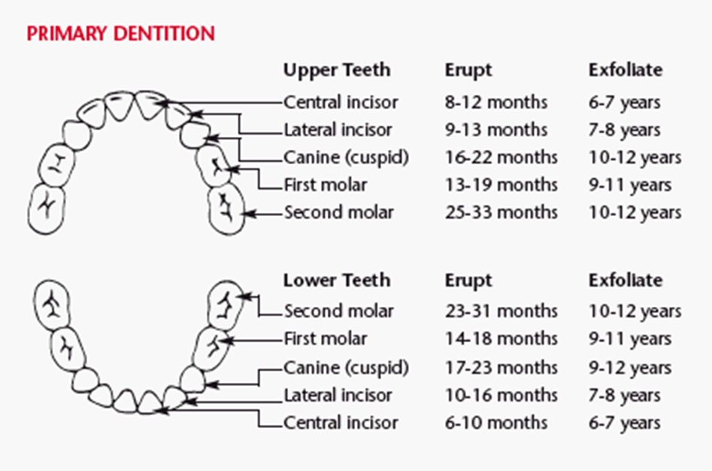

Slide 25
2-Physiological growth
• Physiological growth of infants:-
- Pulse 110-150 b/min
- Resp 35 ± c/min
- Blood pressure 80/50 ± 20/10 mmHg

Slide 26
The Development of Infant stage:-
1. Psychosocial Development: Developing a Sense of Trust (Erikson)
Erik Erikson's phase I (birth to 1 year) is concerned with acquiring a sense of trust while overcoming a sense of mistrust. The trust that develops is a trust of self, of others, and of the world. Infants "trust" that their feeding, comfort, stimulation, and caring needs will be met.
The crucial element for the achievement of this task is the quality of both the relationship between the parent (or caregiver) and child and the care the infant receives. The provision of food, warmth, and shelter by itself is inadequate for the development of a strong sense of self. The infant and parent must jointly learn to satisfactorily meet their needs for mutual regulation of frustration to occur. When this synchrony fails to develop, mistrust is the eventual outcome.

Slide 27
2. Motor Development
1-Fine motor development:-
• Holds hand in fist
• When crying, he draws arms and legs to body Reflexes:-
• Swallowing, Gagging, Sucking, Grasp, Tonic-neck)
• One month-Reflexes (Tonic neck, Grasp R., Crawl R., Step Reflex)
2-Gross Motor Development:-
- At 2 months, the infant can
• Hold head erects in mid-position.
• Turn from side back.

Slide 28
At 4 months, the infant can
• Sit with adequate support.
• Roll over from front to back.
• Bring hands together in midline and plays with fingers.
• Grasp objects with both hands
- At 6 months, the infant can
• Sit alone briefly.
• Turn completely over ( abdomen to abdomen ).
• Lift chest and upper abdomen when prone.
• Hold own bottle.

Slide 29
At 9 months, the infant can
• Rise to sitting position alone.
• Crawl (i.e., pull body while in prone position).
• Hold one bottle with good hand-mouth coordination
-At 10 months, the infant can
• Creep well (use hands and legs).
• Walk but with help.
• Bring the hands together
-At 11 months , the infant can
• Walk holding on furniture.
• Stand alone

Slide 30
-At 12 months , the infant can
• Stand-alone for variable length of time.
• Site down from standing position alone.
• Walk in few steps with help or alone (hands held at shoulder height for balance).
• Pick up small bits of food and transfers them to his mouth Ambulation(motor growth)
-Ambulation(motor growth)
• 9 month old: crawl
• 10 month old: creep
• 1 year: stand independently from a crawl & creep position
13 month old: walk quickly
15 month old: can run

Slide 31
3- Emotional infant development
• His emotions are instable, where it is rapidly changes from crying to laughter.
• His affection for or love family members appears.
4- Cognitive infant Development
• Communicate at first by crying
• Begin to say a few words
• Explore objects by touching and putting them in their mouth
• Piaget explain cognitive development as (sensori-motor)it mean the infant explain his sensation by motor movement

Slide 32
5- Social Development
• He learns that crying brings attention.
• The infant smiles in response to smile of others.
• The infant shows fear of stranger (stranger anxiety).
• He responds socially to his name.
• According to Erikson, the infant develops sense of trust or mistrust. Through the infant's interaction with caregiver (mainly the mother), especially during feeding, he learns to trust others through the relief of basic needs.
Rolls over; Sits up; Stands.
Able to say one to two words.
Uses pincer grasp well.

Slide 33
6- Language development of infant stage
• During infancy language development begins
• Crying represents the infants means of verbal communication
• As early as age 5-6 weeks ,an infant vocalizes with short throaty sound by age 8 months ,more consonants and combined syllables. such as mama , dada (although without comprehension of meaning )and by age 1 year, several short words with meaning .

Slide 34
Play and playing
• Unoccupied Play (birth -3 months )
• At this stage baby is just making a lot of movements with their arms, legs, hands, feet, etc. They are learning about and discovering how their body moves. In the age 9 to 10 months: play simple games with adults ,e. g. ‘’bye-bye’’. play with adult games such as ‘’peek-a-boo’’ by 10 months

Slide 35
Nutrition
Nutrition is an essential component for healthy growth and development. Human milk is the preferred form of nutrition for all infants. Breastfeeding provides the infant with micronutrients, immunologic properties, and several enzymes that enhance digestion and absorption of these nutrients.
Infant Feedings
(Birth to 1 Month )
• Breast every 2 to 3 hours
• Bottle every 3 to 4 hours
(Two to 4 Months)
• Breast or bottle every 3 to 4 hours
(Four to 6 Months)
• Breast or bottle four to six times per day
(Six to 8 Months)
• Iron-fortified rice cereal
• Breast or bottle four times per day

Slide 36
(Eight to 10 Months)
• Finger foods (when the pincer grasp is present, the child is developmentally ready for finger foods)
• Chopped or mashed foods
• use cup with formula, breast milk, juice, or water
• Breast or bottle four times per day
(Ten to 12 Months)
• Self-feeding with fingers and spoon
• Most table foods allowed
• Breast or bottle four times per day

Slide 37
Sleeping patterns of infants
Sleep patterns vary among infants, Generally by 3 months of age, most infants sleep is 15 total hours with a nocturnal pattern of sleep that lasts from 9 to 11 hours and approximately three 1- to 2-hour naps
during the day. Consolidation of nocturnal sleep hours occurs during
the first 12 months, with decreasing daytime sleep and increasing nighttime sleep (approximately 11.7 hours) by 1 year of age.

Slide 38
Needs of Infants
1. Love and security
2. Feeding (breast feeding)
3. Immunization
4. Sleep ,rest and quit environment
5. Safety measurement accident prevention
6. Playing
7. Bathing and clothing
8. Sucking pleasure
9. Fresh air and sunshine
10. Dental care

Slide 39
BASIC NEEDS
Maslow’s Hierarchy of Needs
Basic needs at each level need to be met before a child can progress to the next highest level of growth and development.
Number One: Physiological needs must be met first: food, rest, air ,water.
Number Two: Activity is needed for stimulation, novelty, and change.
Number Three: The child has the need to be protected from harm and feel safe.
Number Four: Feeling loved and part of a group.
Number Five: Esteem needs to develop—the need to respect yourself and be respected by others.
Number Six: Self-actualization, or becoming a complete person and reaching your greatest potential

Slide 40
Accident prevention
Common infants Accidents and Injuries
1. Aspiration (small things)
2. Burn
3. Falls
4. Injury by sharp instruments
5. Drowning
6. Suffocation
7. Poisoning
8. Motor damage

Slide 41
Prevention
1. Instructing parents to maintain a safe environment for the infant by keeping breakables, sharp objects, and harmful substances out of reach.
2. Alert parents to age-specific potential injury sources and accident-prevention strategies.
3. Encourage parents to avoid repetitive negative expressions for the sake of safety and to stress positive aspects of the infant's behavior, such as playing with suitable.

Slide 42
NEWBORN AND INFANT CARE GIVING GUIDELINES
Establish a daily routine
Talk to infants
Hold infants close while giving care
Provide an interesting environment
Be relaxed and calm
When holding young infants, support their head and neck.
Make the environment safe for the child by removing harmful
objects that are within their reach.
Choose toys that are safe; check the size and sturdiness.
Pay special attention to their safety when they are crawling.

Slide 43
SUMMARY OF NURSING INTERVENTIONS
▪Encourage parents to hold and stay with infant.
▪Provide opportunities for sucking.
▪Provide infant with toys that give comfort or stimulate interest

Slide 44
Home work
What are the Problems of neonate child?
Daily Living Activities in neonate ?

Slide 45


